Slide 1


Building better Web Apps by Automating Tests with Selenium WebDriver
@Paul_Hadfield

Slide 2
Tonight’s Presentation
About me:
Tech lead at Coverwise
Online travel insurance company, based out of Worthing
Have used Selenium in past roles to improve quality of automated testing
I’ll introduce:
Selenium WebDriver
Page Object Model
XUnit Test Framework
And show how to use the above in combination to:
Simplify building complex test flows
Test multiple sites, sharing test and domain logic

Slide 3
What is Selenium WebDriver?
Consists of three parts:
Browser
WebDriver
Executable
WebDriver Language Specific API

Slide 4
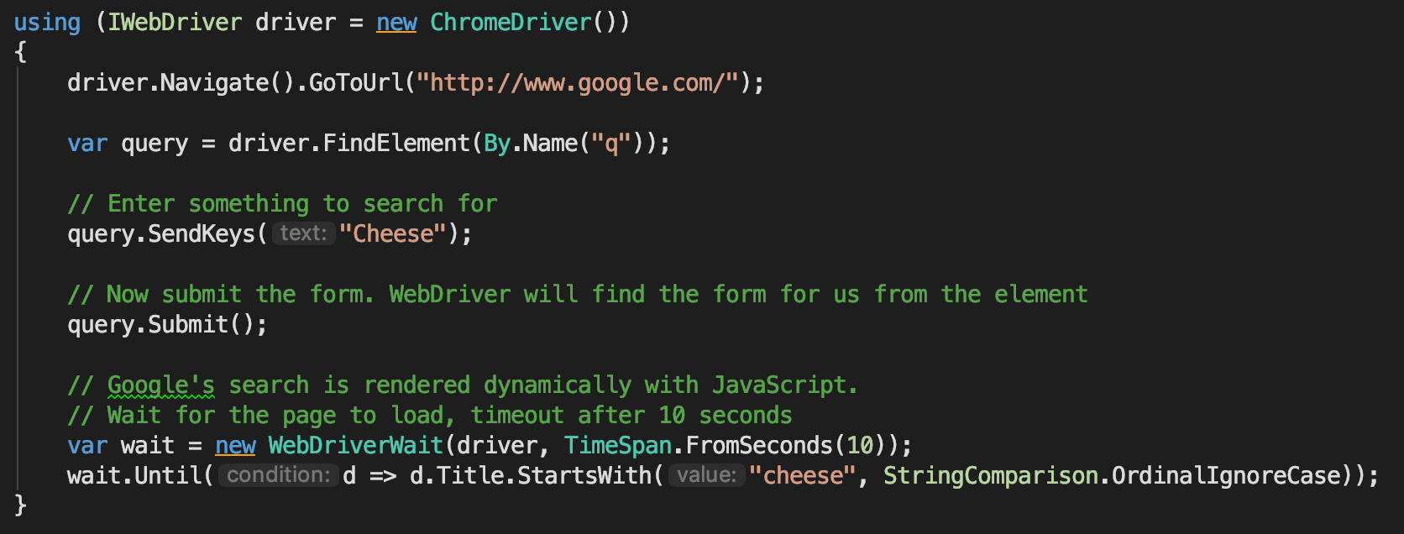
Introducing Selenium
https://www.seleniumhq.org/

Slide 5
Navigation
WebDriver uses methods on the object returned by the method ‘Navigate()’
.GoToUrl()
This functionality is duplicated by the call ‘WebDriver.Get()’
.Back()
.Forward()
Note: WebDriver may not always wait for the page to finish loading before returning control from the above methods. The recommended approach is to wait for a known object to become available on the page.

Slide 6
Finding Elements
WebDriver uses ‘By.*’ strategies to locate desired element(s):
By.Id
By.ClassName
By.TagName
By.Name
By.LinkText
By.PartialLinkText
By.CssSelector
By.XPath

Slide 7
Operating on Elements
Once an element has been selected, it can be operated on:
.Text
.DeselectAll()
.SelectByText(value)
.Click()
.Submit()

Slide 8
Other Operations
Other operations include:
.SwitchTo()
.Frame(value)
.Window(value)
.Alert()
.Manage()
AddCookie(value)
DeleteCookieNamed(name)
DeleteCookie(value)
.DeleteAllCookies()

Slide 9
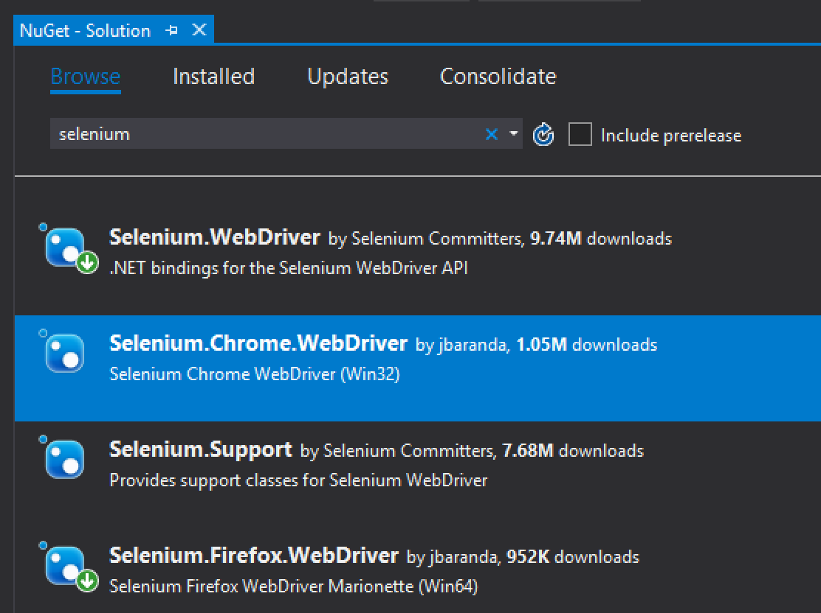
Installing WebDriver Using NuGet (.NET)
Packages:
Selenium.WebDriver: The main package, installs the Selenium API for use in .NET
Selenium.Chrome.WebDriver: Installs ChromeDriver.exe to allow Selenium API to communicate with Chrome
Selenium.Firefox.WebDriver: Installs GeckoDriver.exe to allow Selenium API to communicate with FireFox

Slide 10
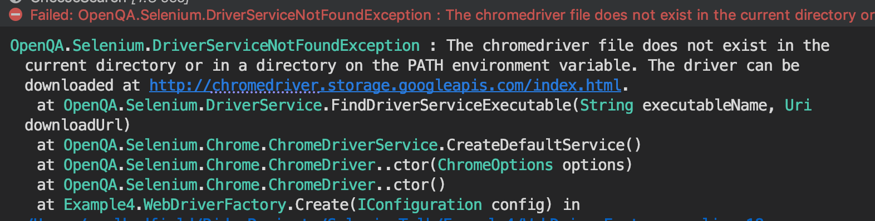
Potential Error
Install ChromeDriver/GeckoDriver executables:
https://www.kenst.com/2015/03/including-the-chromedriver-location-in-macos-system-path/
https://www.kenst.com/2016/12/installing-marionette-firefoxdriver-on-mac-osx/

Slide 11
Demo 1 – Introducing Selenium
Demo Time

Slide 12
Demo 1 – Introducing Selenium
Pros:
Most basic approach, initial fast feedback
Works with example code on Selenium site
Good Scratch Pad!
Cons:
Tests run as all or nothing
Have to provide all the plumbing code a test framework gives you
Hard coded to a single browser (code change to switch)

Slide 13
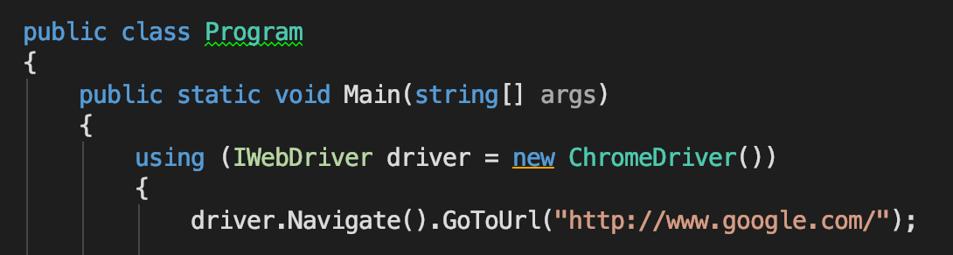
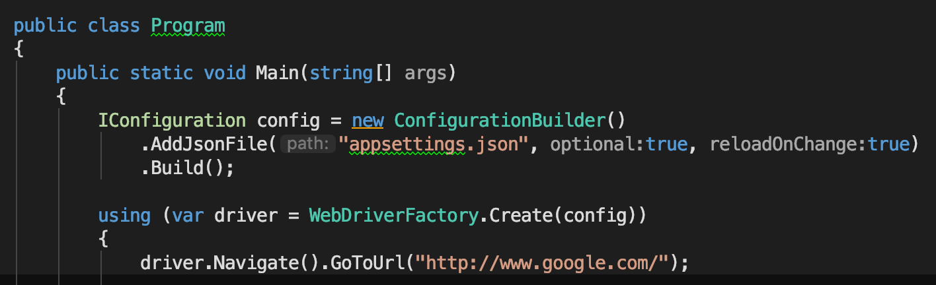
Demo 2 - Browser Independence
Using ‘Abstract Factory’ Design Pattern and Configuration
https://en.wikipedia.org/wiki/Abstract_factory_pattern

Slide 14
Problems with in-line code
In-line code will not scale as the number of tests increases
Ease of cut/paste promotes repeated code/logic
Element ’selector’ logic is mixed in with domain/test logic

Slide 15
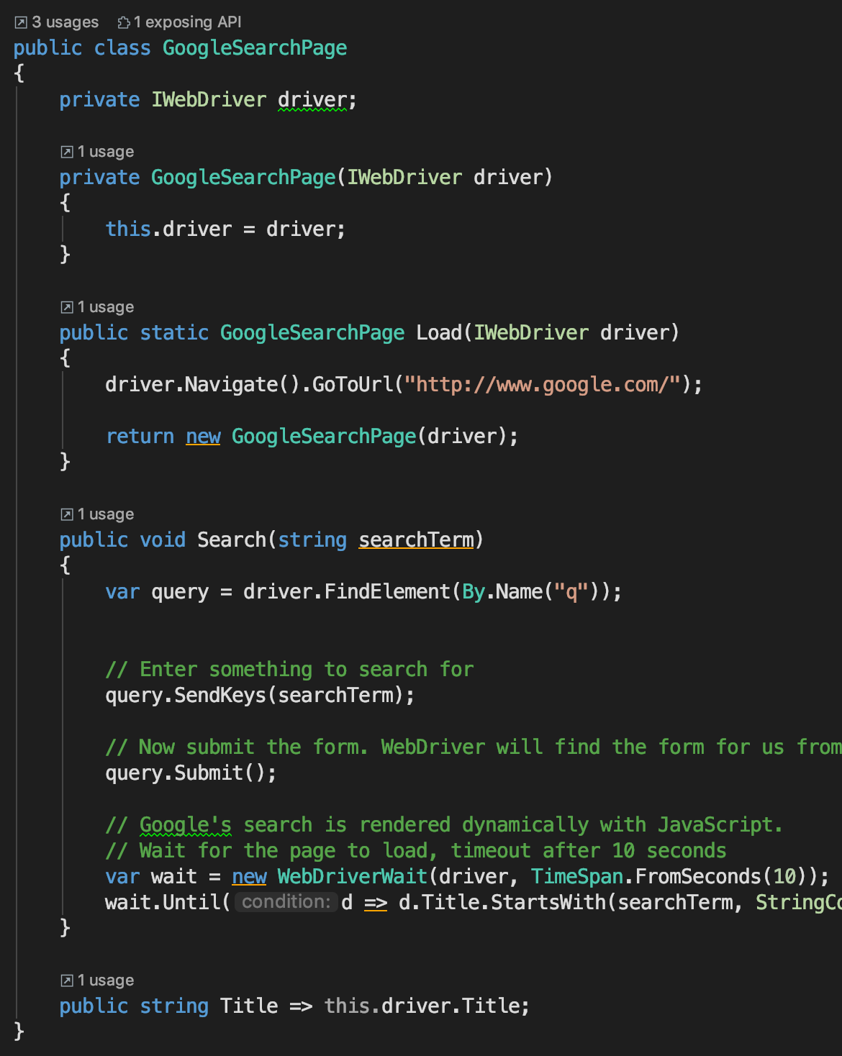
Introducing Page Object Model
Page Object Model solves this by:
A single class represents the page
i.e. GoogleSearchPage
Class Methods represent page actions
i.e. Load(url), Search(value)
Class Properties represent page data
i.e. PageTitle, Url, SearchText

Slide 16
Demo 3 – Page Object Model
Demo Time

Slide 17
Demo 3 – Page Object Model
Pros:
Separates page selection logic from the calling code
Code (page) reuse
Cons:
More complexity, requires more initial set-up

Slide 18
Introducing Test Frameworks
Provide scaffolding for repeatably running multiple pass/fail tests
Popular Frameworks:
NUnit:
https://nunit.org/
XUnit:
https://xunit.github.io/
Specflow:
https://specflow.org/
Machine.Specs (MSpec)
https://github.com/machine/machine.specifications

Slide 19
AAA Test Principles
AAA stands for:
Arrange all necessary preconditions and inputs
Act on the object or method under test
Assert that the expected results have occurred
See http://wiki.c2.com/?ArrangeActAssert

Slide 20
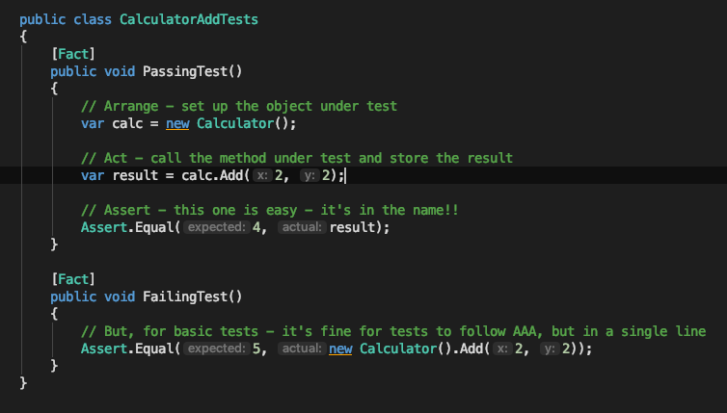
Example XUnit Tests

Slide 21
Demo 4 – Using a Test Framework
Demo Time

Slide 22
Demo 4 – Using a Test Framework
Pros:
Code now clearly passes or fails
Test framework provides us a lot of value/scaffolding
Cons:
Additional dependencies compared to console applications
Need to learn the test framework, as well as Selenium

Slide 23
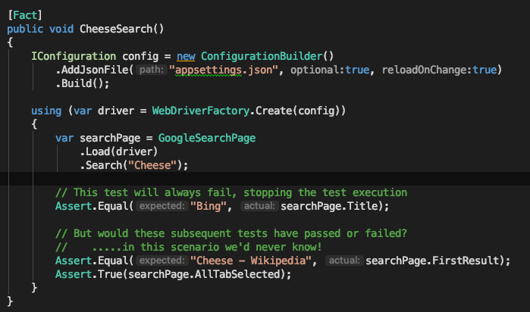
Multiple Asserts in a Single Test issue
Consider the following asserts
We’re checking 3 things
But only learn of first failure
Solution is to have a single assert per test (fact)

Slide 24
Demo 5 – Single Asserts per Test
Demo Time

Slide 25
Demo 5 – Single Asserts per Test
Pros:
No potential ‘hidden failures’
Each and every assert is evaluated
Cons:
In XUnit, the class constructor fires once per Fact (test)
Resulting in a lot more time running Selenium

Slide 26
Introducing ‘Class Fixtures’ – Shared Context
XUnit has ‘Class Fixtures’ to provide shared context between tests
Injected into constructor of test class
Test Framework manages life time of fixture instance
Ensuring only one instance of fixture for all tests (Facts) in referenced class
https://xunit.github.io/docs/shared-context

Slide 27
Shared Context – Alternative Frameworks
Shared Context normally has a (test) framework specific solution
NUnit solves this with ‘OneTimeSetUp’ attribute
MSTest has ‘ClassInitialize’ attribute
Mspec uses static ‘state’, so can probably just use a static constructor
Specflow appears to use context injection to solve this issue
Note: Shared context is generally considered an anti-pattern
However, Selenium is just too slow to repeat steps for every test (Fact)

Slide 28
Demo 6 – Class Fixtures
Demo Time

Slide 29
Demo 6 – Class Fixtures
Pros:
Shares arrange/act steps between all the Facts in a class
Cons:
XUnit specific solution (although other frameworks have their own solutions)
Added complexity

Slide 30
Building on the Page Object Model
Calling GoogleHomePage.Search(value)
Returns a populated instance of “GoogleSearchResults”
Calling on a GoogleSearchResults.WikipediaResult(value)
Returns instance of “WikipediaPage”
Or throws an error if requested Wikipedia result can’t be found
GoogleHomePage
Search
GoogleSearchResults
WikipediaResult
WikipediaPage

Slide 31
Page Object Model – Class Diagram
GoogleHome
PageObject
Operates on
Inherits
GoogleResults
PageObject
BasePageObject
GoogleHome
Tests
GoogleHome
Fixture
Wikipedia
PageObject
GoogleSearch
Tests
Injected
GoogleSearch
Fixture
SelectResult
Tests
SelectResult
Fixture
Inherits
BaseFixture
Asserts
Targeted Tests
Arrange / Act
Common Web Driver Functionality

Slide 32
Demo 7 – Multiple Page Objects
Demo Time

Slide 33
Demo 7 – Multiple Page Objects
Pros:
Separates page logic into relevant, focussed objects
Cons:
Needs more up front planning before coding

Slide 34
Sharing Tests Between Similar Sites
A single suite of tests shared between
White labelled sites
Different languages
i.e. Region specific websites (.co.uk, .it, .fr, .es)
Different companies websites, providing the same functionality
i.e. Google, Bing, Duck Duck Go

Slide 35
Sharing Tests - Class Diagram
GoogleHome
PageObject
Operates on
Inherits
BingHome
PageObject
BaseHome
PageObject
GoogleHome
PageTests
GoogleHome
PageFixture
Inherits
DuckDuckGoHome
PageObject
BaseHome
PageTests
BingHome
PageTests
Injected
BingHomePage
Fixture
DuckDuckGoHomePageTests
DuckDuckGoHomePageFixture
Inherits
BaseHome
PageFixture
Inherits
BaseFixture
Asserts
Common Tests
Asserts
Targeted Tests
Arrange / Act
Common Web Driver Functionality

Slide 36
Demo 8 - Sharing Tests
Demo Time

Slide 37
Demo 8 - Sharing Tests
Pros:
Maximises test code reuse
Can share common page object model code via inherited base classes
Repeatable pattern that can be applied to all tests
Cons:
Complex class hierarchy

Slide 38
Demo 9 – Coverwise sites
Multiple regions:
United Kingdom
Germany
Denmark
All sites have common flow
Pages are in different languages
Different technologies used across various sites
Market specific versions of selecting trip details to start quote journey

Slide 39
Recap
We’ve learnt about and seen examples on how to use:
Selenium WebDriver
Page Object Model
XUnit Test Framework
We’ve also then seen how to use the above in combination to:
Simplify building complex test flows
Test multiple sites, sharing test and domain logic

Slide 40
Thank you – Any questions?
GitHub: https://github.com/Paul-Hadfield/Selenium-Talk
Slides and source code can be found here
Contact me on Twitter: @Paul_Hadfield
Stack Overflow:
https://stackoverflow.com/questions/tagged/selenium-webdriver

